Slide 1

ANNAMACHARYA INSTITUTE OF TECHNOLOGY AND SCIENCES::TIRUPATI (AUTONOMOUS) DEPARTMENT OF ARTIFICIAL INTELLIGENCE A.Y.: 2024-2025 FIRST REVIEW [Academic year: 2024-25 * Batch: 2021-25]
Under the Guidance of
Mrs K.Jagadeeswari, M.Tech., (Ph.D)
Assistant Professor
Department of AI
AITS, Tirupati.
Head of the Department
Dr. C.Siva Balaji Yadav, M.Tech., Ph.D
Associate Professor
Department of AI
AITS, Tirupati

Slide 2
PROJECT TITLE
Image Forgery detection using MD5 and openCV
AIDS-1- BATCH NO: 04
21AK1A3033 P.LAKSHMI PRIYANKA
21AK1A3017 V. GANESH
21AK1A3051 M.NAYUM BASHA
21AK1A3037 B.MAMATHA

Slide 3
ABSTRACT
Because cameras are so widely accessible, taking pictures has grown in popularity recently. Photos are crucial to our everyday lives since they are replete with information, and it is sometimes necessary to improve images in order to get more information. Although there are many technologies available to enhance picture quality, they are also regularly used to alter photos, which leads to the dissemination of false information. This makes picture forgeries more severe and frequent, which is now a major cause of worry. To identify fake images, several conventional methods have been developed over time. openCV have drawn a lot of interest in recent years, and they have also had an impact on the area of picture fraud detection. However, the majority of openCV-based picture forgery detection methods currently used in the literature are restricted to identifying a certain kind of fraud (either image splicing or copy-move). Therefore, it is necessary to develop a method that can quickly and precisely identify any hidden forgeries in an image. In the context of double image compression, we describe in this study a robust deep learning-based approach for detecting picture forgeries.

Slide 4
DOMAIN INTRODUCTION
Image forgery involves manipulation techniques like splicing, cloning, and retouching to alter the content of digital images.
Detecting forgeries is crucial in fields such as journalism, law enforcement, and digital security to ensure authenticity and reliability.
OpenCV provides essential tools for image processing, feature extraction, and pattern recognition, aiding in the detection of forged regions.
MD5 hashing generates unique hash values for images, allowing comparison and detection of tampering through hash mismatches.
Common detection techniques include error level analysis, pixel-level feature analysis, and identifying inconsistencies in image artifacts.
Applications range from verifying digital evidence to authenticating social media content and combating misinformation.
Challenges in this domain include detecting forgeries in low-resolution images, addressing advanced editing techniques, and countering adversarial manipulations.

Slide 5
EXISTING SYSTEM
In early days, to detect the forgery of images is a complex thing. It requires more manual power and it’s a time taking process. There is no accurate detection techniques.
DIS ADVANTAGES EXISTING SYSTEM
Time taking
Low accuracy
High computational cost
Lack of Robustness
Inability to Handle Advanced Forgery Techniques

Slide 6
PROPOSED SYSTEM
In this proposed method, we are using deep learning methods to detect the image forgery. We can detect the image forgery with high accuracy by using openCV and MD5 methods. MD5 gives the better performance in image detection.
ADVANTAGES OF PROPOSED SYSTEM
Requires less time
High accuracy
Better adaptability
Efficient and Scalable
Robust forgery detection

Slide 7
LITERATURE SURVEY
S. No | Title of the Paper | Problem Statement | Method/ Algorithm Used | YEAR | AUTHOR NAMES
1. | Image splicing forgery detection combining coarse to refined convolutional neural network and adaptive clustering | This paper proposes a splicing forgery detection method with two parts: a coarse-to-refined convolutional neural network (C2RNet) and diluted adaptive clustering | Coarse-to-Refined Convolutional Neural Network (CNN), Adaptive Clustering | 2020 (Journal) | Xiao, B.; Wei, Y.; Bi, X.; Li, W.; Ma, J
2. | CAT-Net: Compression Artifact Tracing Network for Detection and Localization of Image Splicing | Detecting and localizing image splicing has become essential to fight against malicious forgery | CNN, Autoencoders, Feature fusion | 2021 (WACV) | M.J.; Yu, I.J.; Nam, S.H

Slide 8
S.No | Title of the Paper | Problem Statement | Method/ Algorithm Used | YEAR | AUTHOR NAMES
3. | ManTra-Net: Manipulation Tracing Network for Detection and Localization of Image Forgeries With Anomalous Features | To fight against real-life image forgery, which commonly involves different types and combined manipulations | CNN, Anomaly Detection, Pixel-wise Classification | 2019 (CVPR) | Wu, Y.; Abd Almageed, W.; Natarajan, P
4. | A survey on image tampering and its detection in real-world photos | This survey provides an overview on typical image tampering types, released image tampering datasets and recent tampering detection approaches | Signal Processing Methods, Image Cloning and Morphing Detection | 2019 (Journal) | Zheng, L.; Zhang, Y.; Thing, V.L

Slide 9
MINIMUM SYSTEM REQUIREMENTS
Software Requirements:
Operating System : Windows 10
Server-side Script : Python 3.6
IDE : VS code
Libraries Used : Numpy, IO, OS, Keras, pandas, tensorflow,Opencv
Hardware Requirements:
Processor : I5/Intel Processor
RAM : 8GB (min)
Hard Disk : 128 GB

Slide 10
ANALYSIS AND DESIGN

Slide 11
Analysis
System and User Modules
User:
Data gathering:
Needs to gather the information or data from the open source, this will be use in the train the models.
Pre-processing:
Data need to be pre-processed according the models it helps to increase the accuracy of the model and better information about the data.
Feature Engineering:
In this step features are selected based on the priority of the column data, by this we can reduce the time investing on many columns.

Slide 12
Model Building
To get the final result model building for the dataset is an important step. Based on the dataset we build the model for classification and regression.
View Results
User view’s the generated results from the model.
System:
Model Checking
System checks model accuracy and it takes of the necessary for the model building
Generate Results
System takes the input data from the users and produces the output

Slide 13
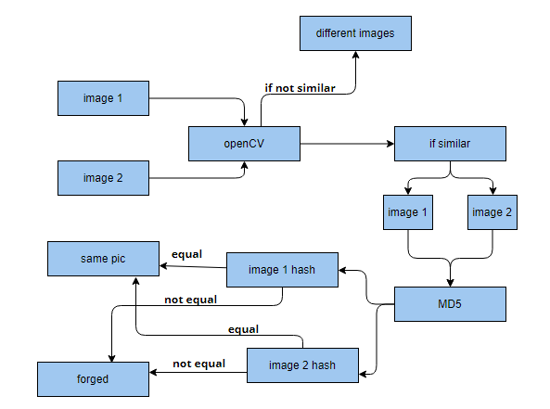
DESIGN
Data Flow Diagram

Slide 14
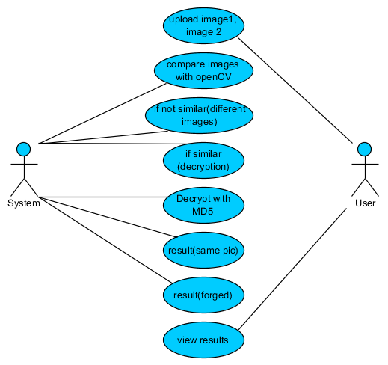
UML DIAGRAMS
USE CASE DIAGRAM

Slide 15
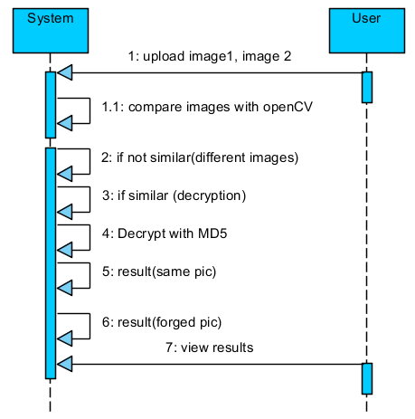
SEQUENCE DIAGRAM

Slide 16
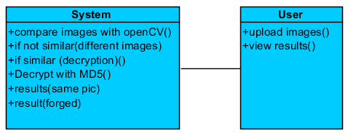
CLASS DIAGRAM

Slide 17
COLLABORATION DIAGRAM

Slide 18
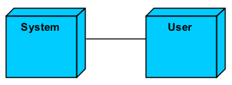
DEPLOYMENT DIAGRAM

Slide 19
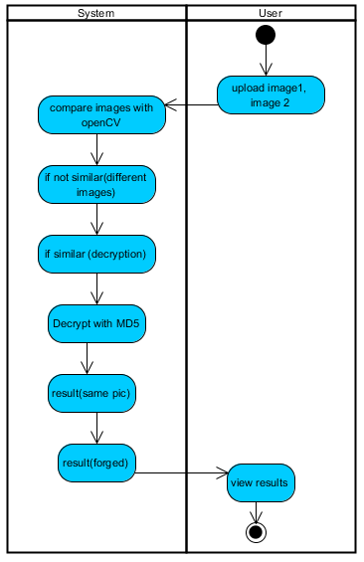
ACTIVITY DIAGRAM

Slide 20
Conclusion
The project has concluded that, we have developed an application by using deep learning methods to detect the image forgery. We can detect the image forgery with high accuracy by using OpenCV and MD5 methods. MD5 gives the better performance in image detection.

Slide 21
REFERENCES
Xiao, B.; Wei, Y.; Bi, X.; Li, W.; Ma, J. Image splicing forgery detection combining coarse to refined convolutional neural network and adaptive clustering. Inf. Sci. 2020, 511, 172–191.
Kwon, M.J.; Yu, I.J.; Nam, S.H.; Lee, H.K. CAT-Net: Compression Artifact Tracing Network for Detection and Localization of Image Splicing. In Proceedings of the 2021 IEEE Winter Conference on Applications of Computer Vision (WACV), Waikoloa, HI, USA, 5–9 January 2021; pp. 375–384.
Wu, Y.; Abd Almageed, W.; Natarajan, P. ManTra-Net: Manipulation Tracing Network for Detection and Localization of Image Forgeries With Anomalous Features. In Proceedings of the 2019 IEEE/CVF Conference on Computer Vision and Pattern Recognition (CVPR), Long Beach, CA, USA, 15–20 June 2019; pp. 9535–9544.
Zheng, L.; Zhang, Y.; Thing, V.L. A survey on image tampering and its detection in real-world photos. J. Vis. Commun. Image Represent. 2019, 58, 380–399.

Slide 22
Thank You!
Any Questions?

